Slide 1



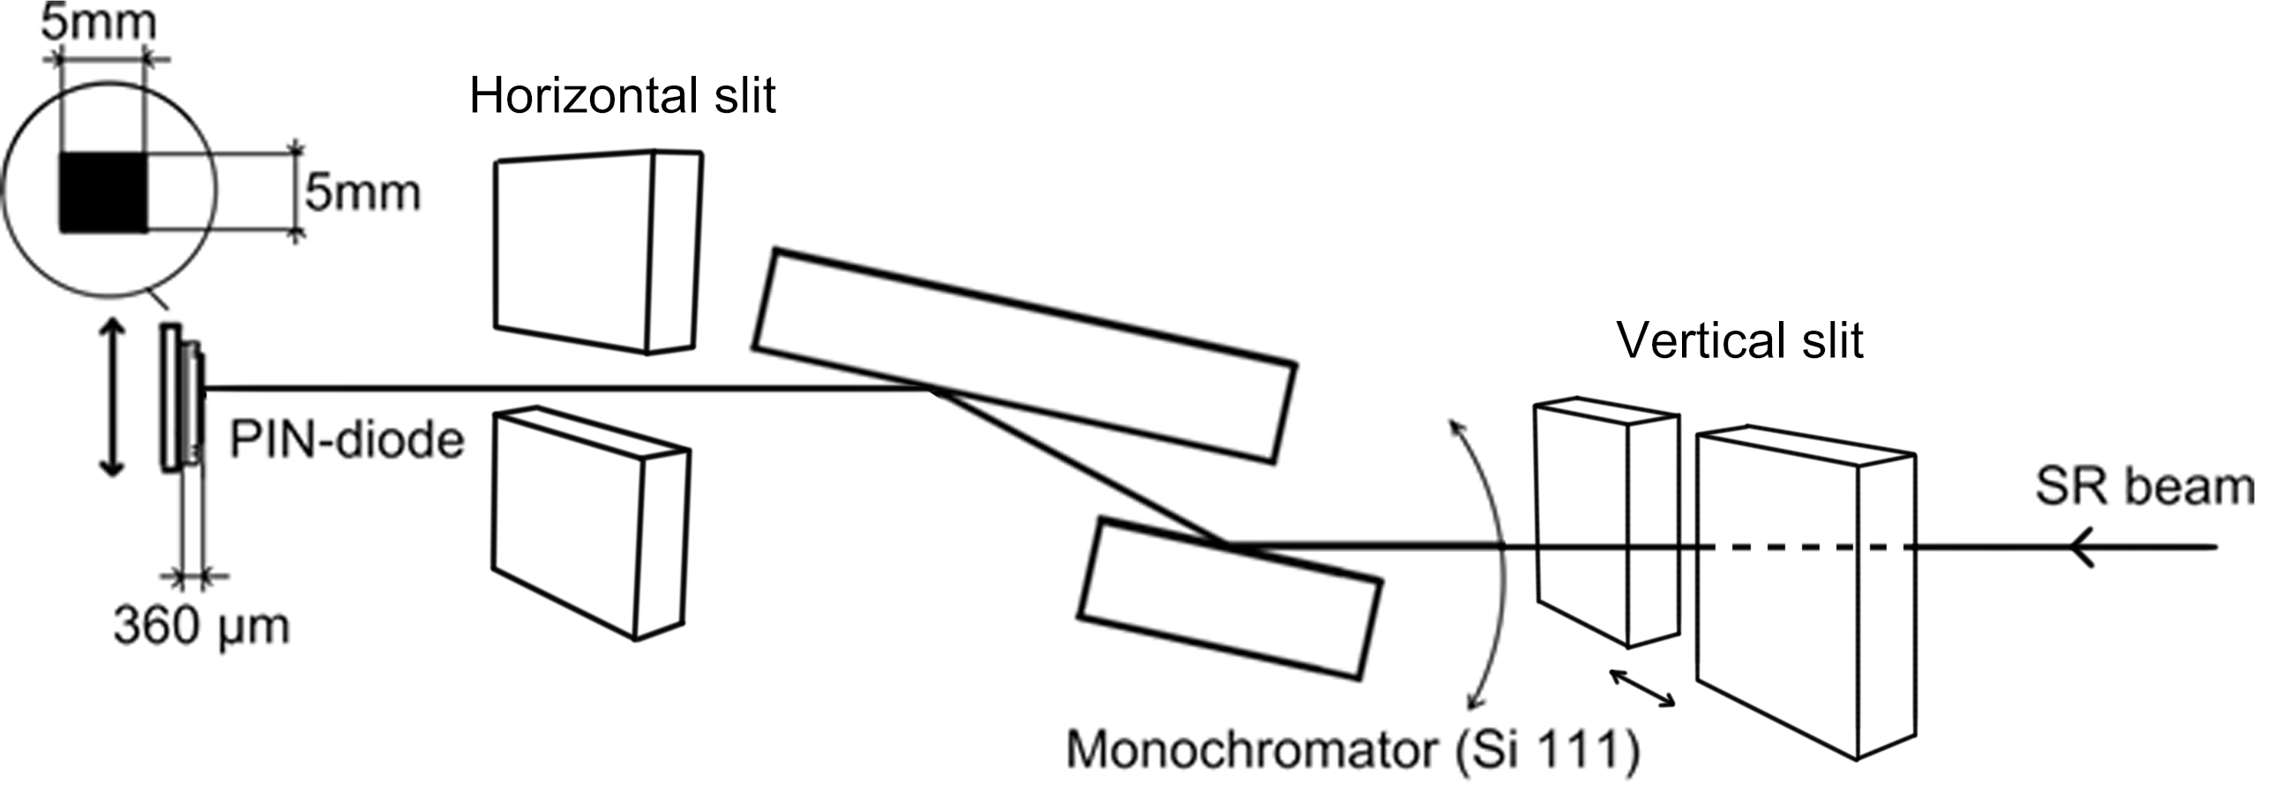
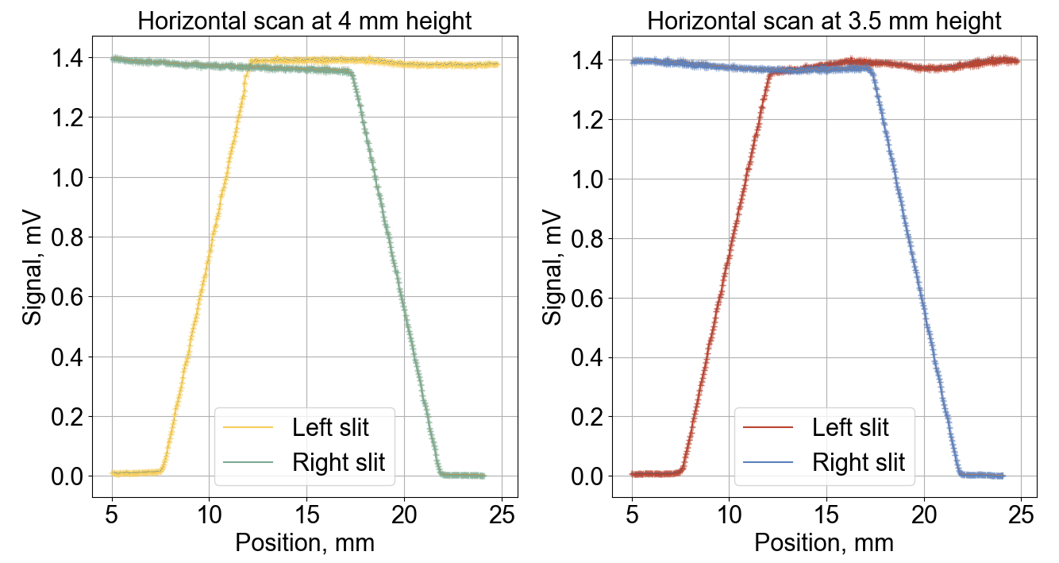
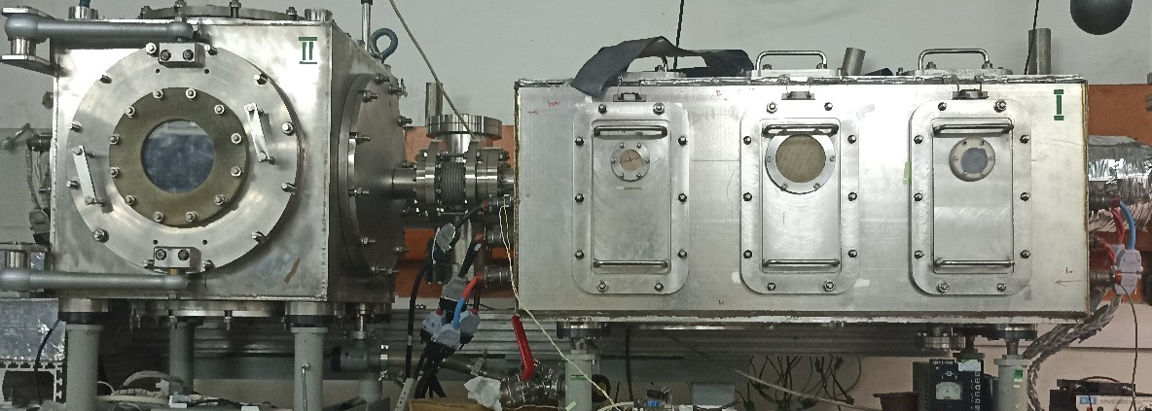
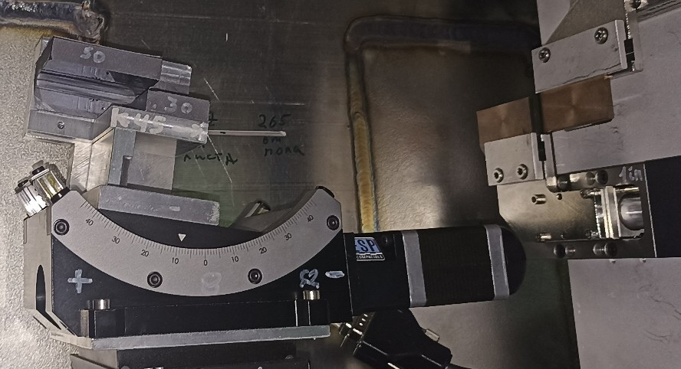
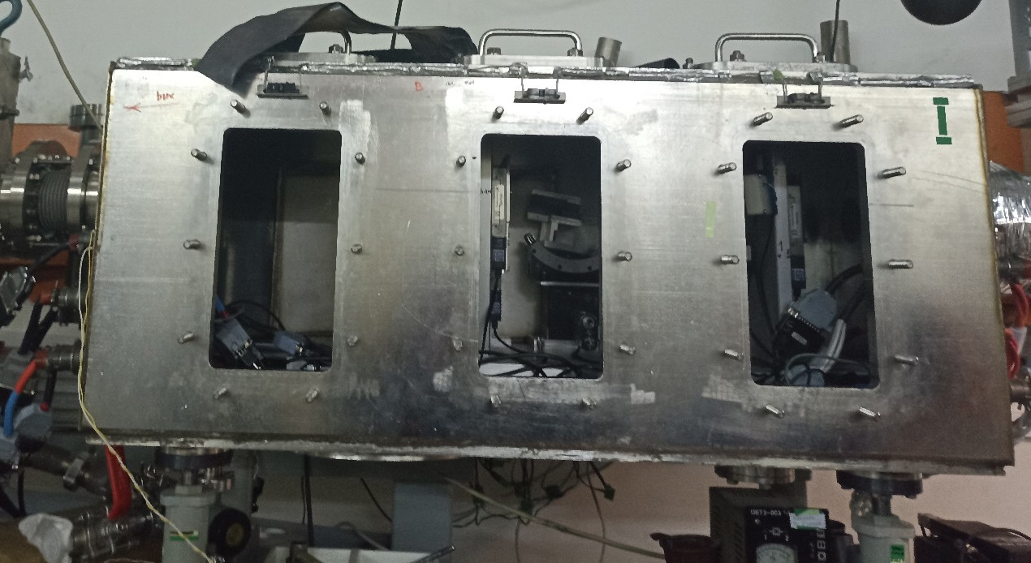
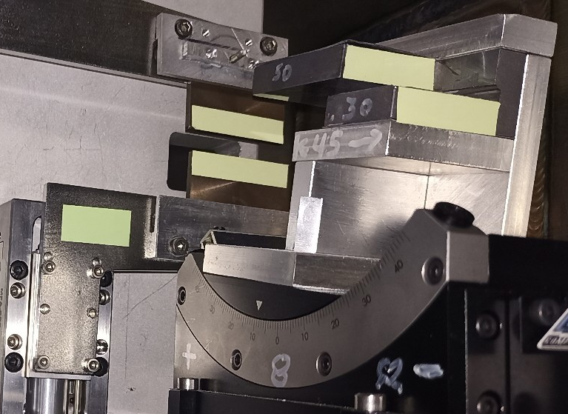
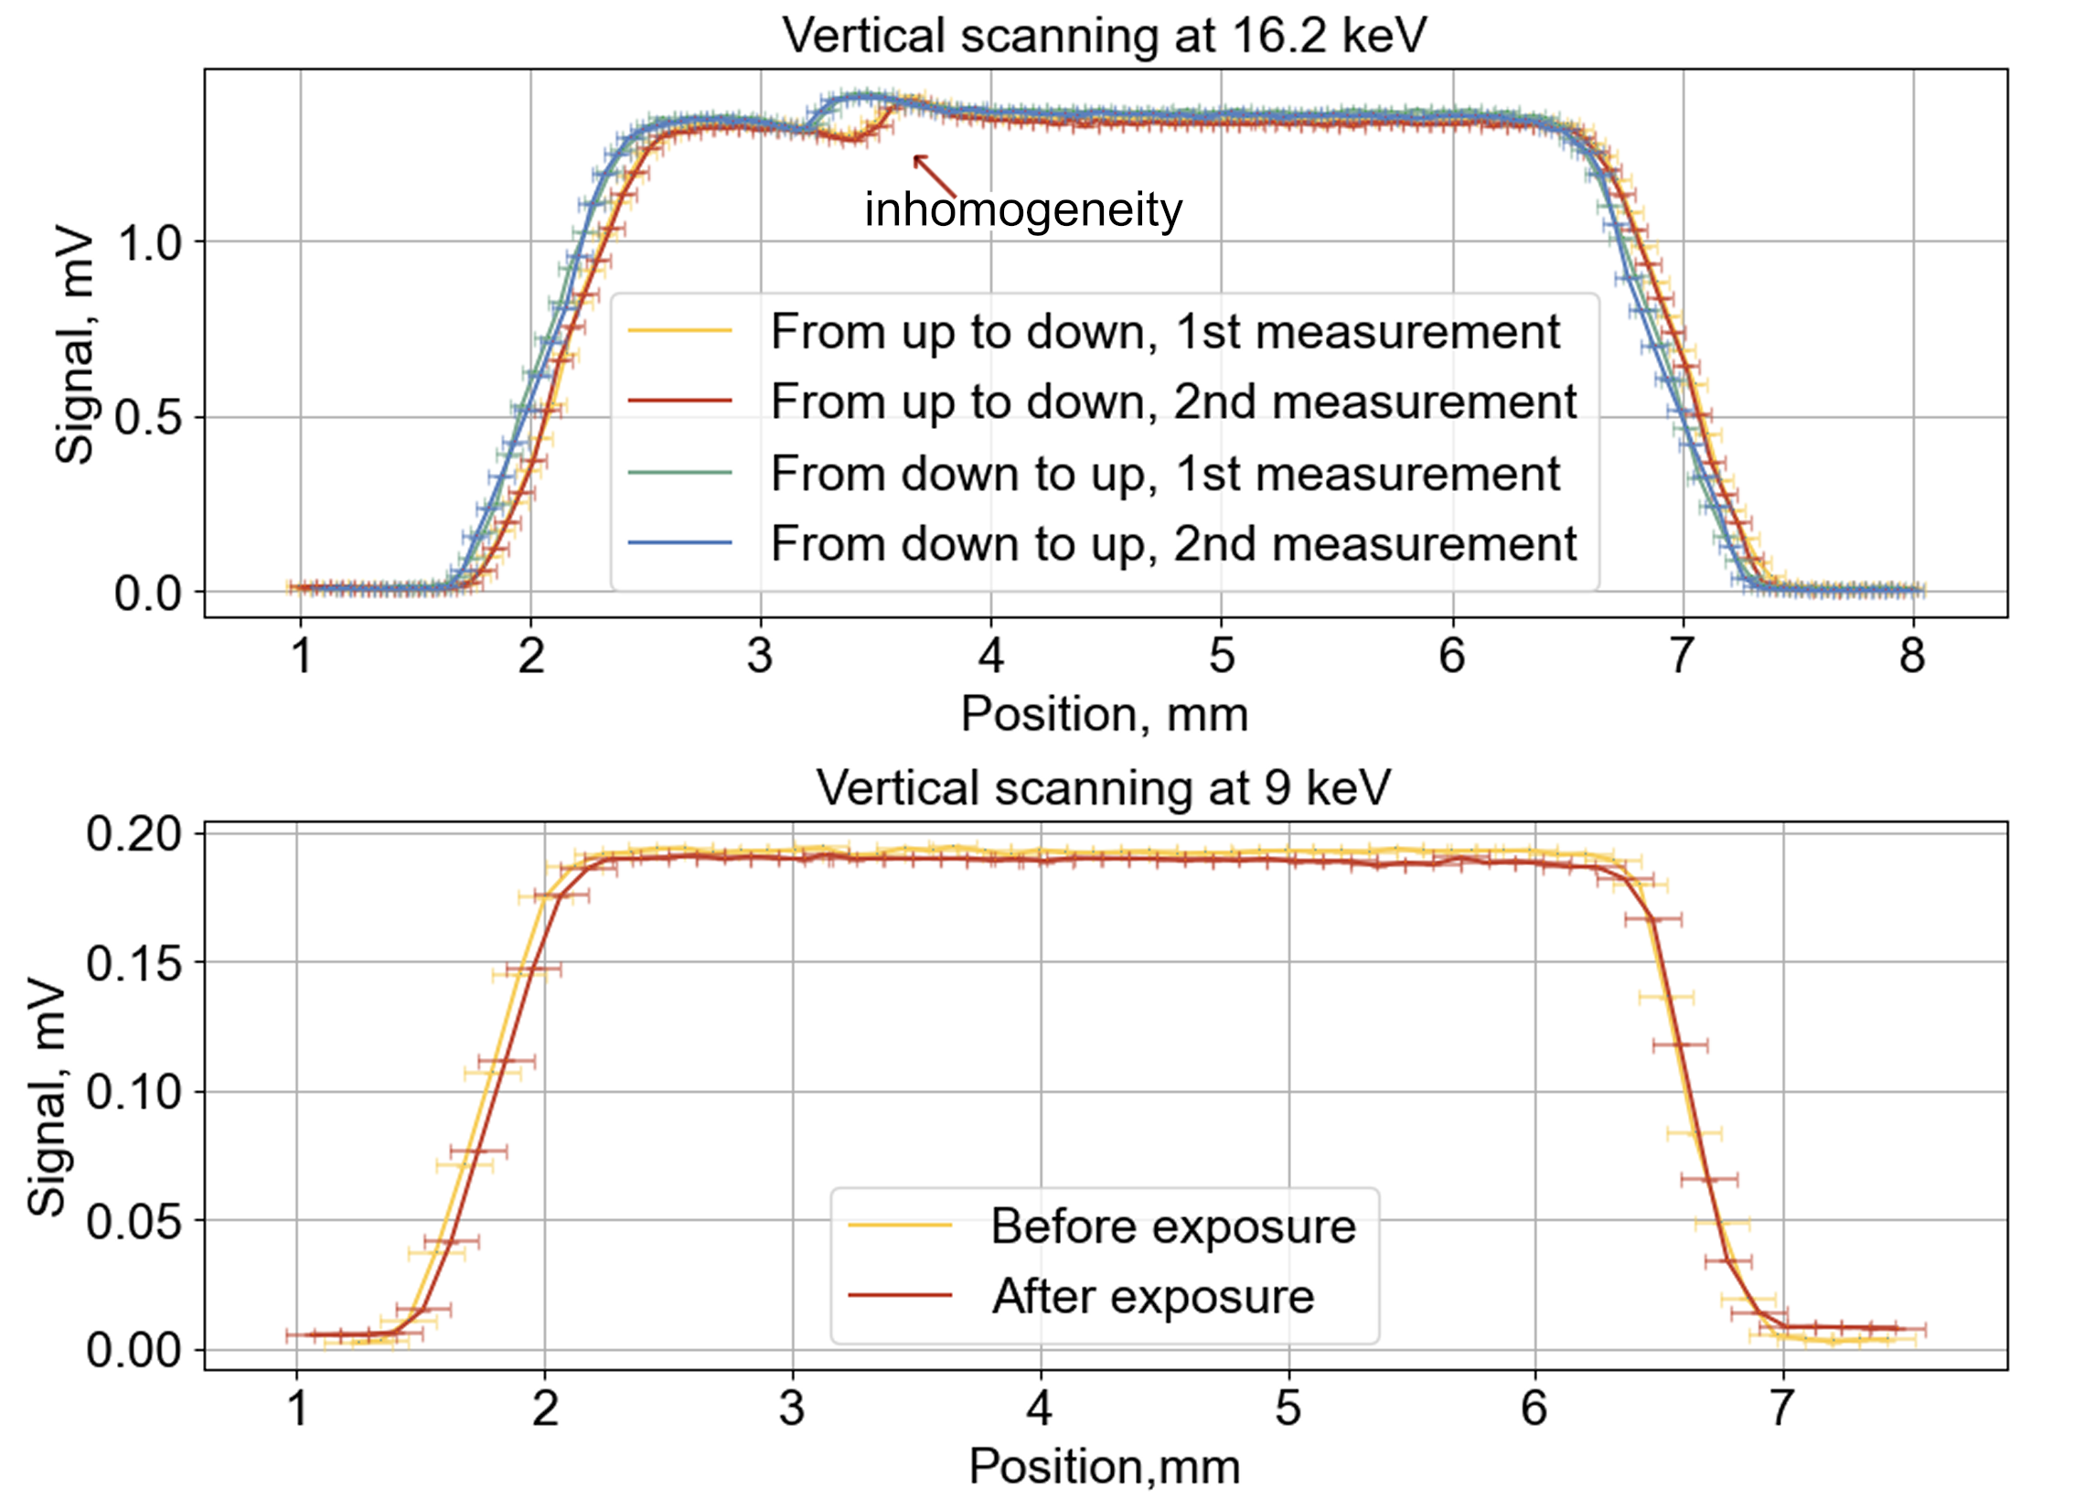
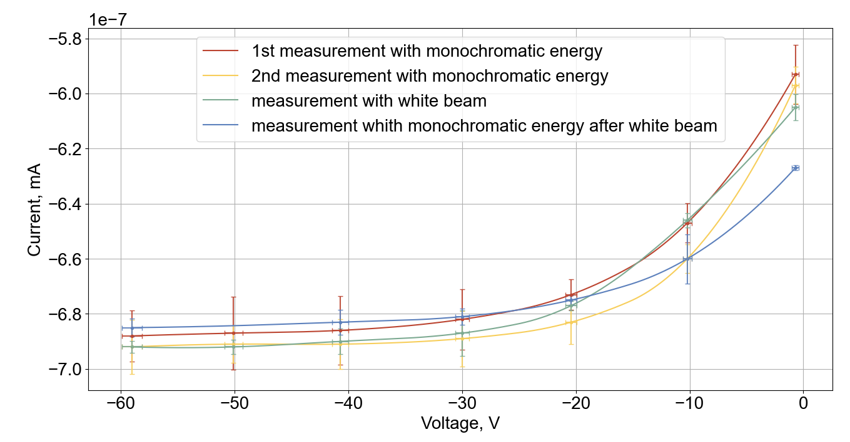




Investigation of the homogeneity of a PIN-diode and the degradation of its current-voltage characteristics under the influence of synchrotron radiation
Институт ядерной физики имени Г. И. Будкера СО РАН
Murzina A.V.¹, Buntina I.D.¹, Khomyakov Yu.V.², Rakshun Ya.V.², Gusev I.S.², Svetokhin S.S.², Chistokhin I.B.³
1 – Novosibirsk State University, 2 – Institute of Nuclear Physics SB RAS, Novosibirsk, Russia, 3 – Institute of Semiconductor Physics SB RAS, Novosibirsk, Russia
INTRODUCTION
EXPERIMENTAL SETUP
In this work, we examined a PIN-photodiode developed at the Institute of Physics SB RAS. The subject of the study was the study of the homogeneity of the PIN diode and its radiation resistance. The study was carried out at a specialized Technological Station VEPP-4 at monochromatic radiation energies of 9 keV and 16.2 keV.
The work was carried out at the Technological Station VEPP-4. Si(111) channel-cut monochromator was used. The size of beam was selected by moving of 2 vertical and 2 horizontal slits.
HOMOGENEITY
The size of the working area of the PIN-diode is determined. It is found that the dependence of the photocurrent on the area of illumination is linear. The presence of an inhomogeneity at an energy of 16.2 keV, which is 3.42% of the entire vertical, has been established. Having given the PIN-diode a vertical coordinate at which the inhomogeneity was observed, an additional horizontal scan was performed along this coordinate. Inhomogeneities were not found. It is assumed that the 16.2 keV signal inhomogeneity is due to the excitation of the L-edge of the gold used as solder in the PIN-diode.
Figure 1. Scheme of the experimental setup
Figure 3. Photo of experimental setup: closed and open flanges and chambers equipped internally with a double-crystal monochromator, goniometer and slits
Figure 3. Photo of the studied PIN-photodiode
Figure 3. Horizontal scan of the PIN-diode. Points are represented by an average sample of 10 measurements
DEGRADATION OF С-V CHARACTERISTIСS
For each bias voltage value, there is a set of signal points in mV from which the average value and the standard deviation are found. The feedback resistance is 300 kΩ, so the desired current is obtained by dividing the signal by the feedback resistance. Similar calculations were carried out for the CVC of the dark current. Interpolated and normalized to the storage current, the difference in the C–V characteristics is shown in the figure. Taking into account the errors, it can be concluded that there is no degradation of the photodiode.
Figure 4. Vertical scan of the PIN-diode at different energies. The second plot shows scans before and after white beam irradiation. Points are represented by an average sample of 10 measurements
Figure 5. Current-voltage characteristics of PIN-diode before and after irradiation
RADIATION DOSE
CONCLUSION
The photodiode was irradiated for 60 minutes with monochromatic X-rays at an energy of 9 keV (total dose is 1.1∙10⁵ Gy), which did not lead to a noticeable degradation of the characteristics. Then the diode was irradiated with a «white» beam for 30 minutes (total dose is 5.715 ∙10⁶ Gy), which also did not lead to a change in performance.
It has been shown that despite an external sign of the beam impact, the recorded characteristics remained practically unchanged. The effective uniform area of ​​the PIN-photodiode is 5,1 ± 0,1 x 3,9 ± 0,1 mm. The inhomogeneity of the output signal is 0,54%. A defect has found at an energy 16.2 keV, in its region the inhomogeneity of the output signal of the PIN-diode is 3,42%. The results of the study have shown the suitability of PIN-photodiodes developed by ISP SB RAS in diagnostic systems of monochromatic beams of synchrotron radiation, and at least for short-term use in «white» SR beams.
International Conference «Synchrotron Radiation Techniques for Catalysts and Functional Materials»// October 31 – November 3, 2022 Novosibirsk, Russia

